Slide 1
Chapter 9: Leadership
C H A P T E R
9
Leadership

Slide 2
Session Outline
What is leadership?
How leaders are chosen
Functions of leaders
Approaches to studying leadership
Multidimensional model of sport leadership
(continued)

Slide 3
Session Outline (continued)
Research on multidimensional model of sport leadership
Practical implications: Four components of effective leadership

Slide 4
What Is Leadership?
Leadership is “the process whereby an individual influences a group of individuals to achieve a common goal” (Northhouse, 2001, p. 3).

Slide 5
Leaders Versus Managers
A manager takes care of such things as scheduling, budgeting, and organizing.
A leader provides vision and is more concerned with the direction of an organization, including its goals and objectives.

Slide 6
How Leaders Are Chosen
Appointed or prescribed leaders are individuals appointed by some authority to a leadership position (e.g., health club manager, coach, head athletic trainer).
Emergent leaders are individuals who emerge from a group and take charge (e.g., captain of an intramural team, student leader of an exercise class).

Slide 7
Functions of Leaders
Ensuring that the group meets its goals and objectives
Ensuring that group needs are satisfied

Slide 8
Approaches to Studying Leadership
Trait approach
Behavioral approach
Situational approach
Interactional approach

Slide 9
The Trait Approach
Key question: What personality characteristics are common in great leaders?
Results: Leaders have a variety of personality characteristics. There is no particular set of personality traits that make a leader successful.

Slide 10
The Behavioral Approach
Key question: What are the universal behaviors (not traits) of effective leaders?
Leaders in nonsport settings: Successful leaders use both consideration (focus on friendship, mutual trust, respect) and initiating (focus on rules, goals, and objectives) structures.
(continued)

Slide 11
The Behavioral Approach (continued)
Leaders in sport—instruction and demonstration: Effective coaches focus on the positive while providing clear feedback and technical instruction.
Coaches versus peer leaders
  Coaches exhibit mostly training and instruction and autocratic behavior.
  Peer leaders display social support, positive feedback, and democratic behavior.
(continued)

Slide 12
The Behavioral Approach (continued)
Leaders in sport—reactive and spontaneous behaviors
  CBAS (Coaching Behavior Assessment System)
  Facilitating positive coaching behaviors (frequent use of reinforcement and mistake-contingent encouragement) ensures greater enjoyment, higher self-esteem, and lower dropout rates in young athletes.

Slide 13
Categories of Coaching Behavior Assessment System (CBAS)
Reactive behaviors
  Reinforcement
  Mistake-contingent encouragement
  Mistake-contingent technical instruction
  Punishment
  Punitive technical instruction
  Ignoring mistakes
  Keeping control
(continued)

Slide 14
Categories of Coaching Behavior Assessment System (CBAS) (continued)
Spontaneous behaviors
  General technical instruction
  General encouragement
  Organization
  General communication
See Categories of Coaching Behavior from the Coaching Behavior Assessment System on p. 211 of text.

Slide 15
Behavioral Guidelines for leaders
On the basis of 25 years of research, Smoll and Smith (2001) provide some guidelines for coaching young athletes:
  Do provide reinforcement immediately after positive behaviors and reinforce effort as much as results.
  Do give encouragement and corrective instruction immediately after mistakes. Emphasize what the athlete did well, not what the athlete did poorly.
(continued)

Slide 16
Behavioral Guidelines for Leaders (continued)
  Don’t punish when athletes make a mistake. Fear of failure is reduced if you work to reduce fear of punishment.
  Don’t give corrective feedback in a hostile, demeaning, or harsh manner; that is likely to increase frustration and build resentment.
  Do maintain order by establishing clear expectations. Use positive reinforcement to strengthen the correct behaviors rather than punishment of incorrect behaviors.
(continued)

Slide 17
Behavioral Guidelines for leaders (continued)
  Don’t get into the position of having to constantly nag or threaten athletes to prevent chaos.
  Do use encouragement selectively so that it is meaningful. Encourage effort but don’t demand results.
  Do provide technical instruction in a clear, concise manner and demonstrate how to perform the skill whenever possible.
(continued)

Slide 18
The Situational Approach
Effective leadership is much more dependent on characteristics of the situation than on the traits and behaviors of the leaders in those situations.
Not widely endorsed by itself, but it was important in facilitating our understanding of leadership because it showed that situational features have a major influence on leader success.

Slide 19
The Interactional Approach
Personal and situational factors need to be considered in order to understand effective leadership.
Implications
  No one set of characteristics ensures successful leaders (but characteristics are important).
  Effective leader styles or behaviors fit the specific situation.
  Leadership styles can be changed.
(continued)

Slide 20
The Interactional Approach (continued)
Relationship- and task-oriented leaders compared
  A relationship-oriented leader focuses on developing and maintaining good interpersonal relationships; a task-oriented leader focuses on setting goals and getting the job done.
  The effectiveness of an individual’s leadership style stems from its “matching” the situation.
(continued)

Slide 21
The Interactional Approach (continued)
  Task-oriented leaders are effective in very favorable or unfavorable situations.
  Relationship-oriented leaders are effective in moderately favorable situations.

Slide 22
Sport-Oriented Interactional Approaches to Leadership
Cognitive–mediational model
Multidimensional model

Slide 23
Cognitive–Mediational Model of Sport Leadership
Coach leadership behaviors are a function of their own personal characteristics, which are mediated by situational factors and the meaning athletes attribute to those coaching behaviors.

Slide 24
The Multidimensional Model of Sport Leadership
Leader effectiveness in sport can vary depending on the characteristics of the athletes and constraints of the situation.
Optimal performance and satisfaction are achieved when a leader’s required, preferred, and actual behaviors are consistent.

Slide 25
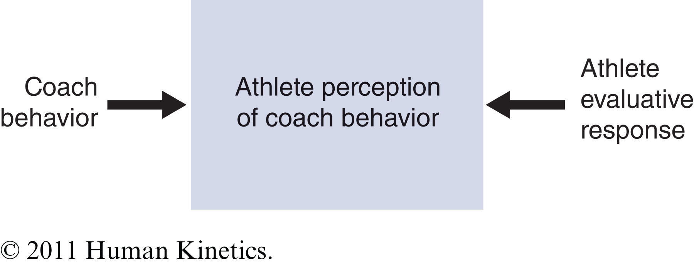
Figure 9.1

Slide 26
Leadership in the Pursuit of Excellence
Leaders who help individuals and teams pursue excellence “transform” the person by facilitating attributes like self-efficacy and competitiveness.
At the same time, leaders create a situation or environment that supports a compelling vision, key goals, and productive motivational climates.

Slide 27
Guidelines for Leadership in the Pursuit of Excellence
Creating a compelling vision for people to follow
Inspirational communication (instilling pride, enhancing morale)
Intellectual stimulation (followers understand the big picture behind what they are doing)
(continued)

Slide 28
Guidelines for Leadership in the Pursuit of Excellence (continued)
Individualized attention and supportive behavior
Personal recognition
Demanding and directing behaviors
Promotion of self-efficacy and esteem
Emphasis on winning (emphasizing the importance of winning but not winning at all costs)
(continued)

Slide 29
Guidelines for Leadership in the Pursuit of Excellence (continued)
Fostering competitiveness in the team
Instilling task and ego orientations and climates (balancing a strong emphasis on task goals while also integrating ego goals in an appropriate fashion)
The provision of cognitive, emotional, and technical training
Facilitating flow

Slide 30
Leadership Scale for Sport
(LSS) Dimensions
Training (instructive behaviors)
Democratic behavior (decision-making style)
Autocratic behavior (decision-making style)
Social support (motivational tendencies)
Positive feedback (motivational tendencies)

Slide 31
Antecedents of Leadership
Age and maturing
Gender
Nationality
Type of sport
(continued)

Slide 32
Antecedents of Leadership (continued)
Age and maturing
  Older, more athletically mature athletes prefer coaches who are more autocratic and socially supportive.
  Preferences for training and instruction behavior decrease from early to senior high school but increase again at the university level.
(continued)

Slide 33
Antecedents of Leadership (continued)
Gender: Males prefer training and instructive behaviors and an autocratic coaching style. Females prefer democratic and participatory coaching that allows them to make decisions.
Nationality: Cultural background may influence leadership preferences (e.g., United States, Britain, Canada, Japan).
(continued)

Slide 34
Antecedents of Leadership (continued)
Type of sport: Participants in highly interactive sports (e.g., volleyball players) prefer an autocratic style more than participants in coaching sports (e.g., bowling) do.
(continued)

Slide 35
Antecedents of Leadership (continued)
Psychological characteristics
  Athletes with internal locus of control show a strong preference for training and instruction, while athletes with external locus of control prefer more autocratic behaviors.
  Females high in trait anxiety prefer more positive and social support behaviors than their counterparts with low trait anxiety.

Slide 36
Consequences of Leadership
Satisfaction
Cohesion
Performance
(continued)

Slide 37
Consequences of Leadership (continued)
Satisfaction
  Coach–athlete compatibility in decision style, generous social support of the coach, rewarding, and democratic decisions are generally associated with higher satisfaction of athletes.
  Team sport athletes find positive coaching behaviors even more important than individual sport athletes do.
(continued)

Slide 38
Consequences of Leadership (continued)
Cohesion
  Coaches high in training and instruction, democratic behavior, social support, and positive feedback and low in autocratic behaviors have teams with greater cohesion.
  Exercise leaders exhibiting more task-related behaviors and providing task-specific reinforcement were associated with more cohesive exercise groups.
(continued)

Slide 39
Consequences of Leadership (continued)
Performance: Losing teams need more social support from their leaders to sustain motivation.
(continued)

Slide 40
Consequences of Leadership (continued)
Intrinsic motivation
  Autocratic (controlling) coaching styles are associated with lower levels of intrinsic motivation and perceived competence.
  Coaching style affects intrinsic motivation and competence and influences athletes’ motivation and persistence.

Slide 41
Four Outcomes of Athlete Leadership Development Through Sport
Development of high skill
Strong work ethic
Good rapport with people
Enriched tactical knowledge

Slide 42
Influencing Athlete Leadership Development
Getting involved with older peers through increasingly challenging competition
Parents mentoring players on complex cognitive sport issues and decision making
Coaches appointing athletes to leadership positions (because of the athletes’ high skill level)
(continued)

Slide 43
Influencing Athlete Leadership Development (continued)
Maintaining good relationships with peers and gaining their trust
Parental support (monetary, encouragement, moral) of sport involvement and activities
Coaches providing an excellent training environment to help develop skill

Slide 44
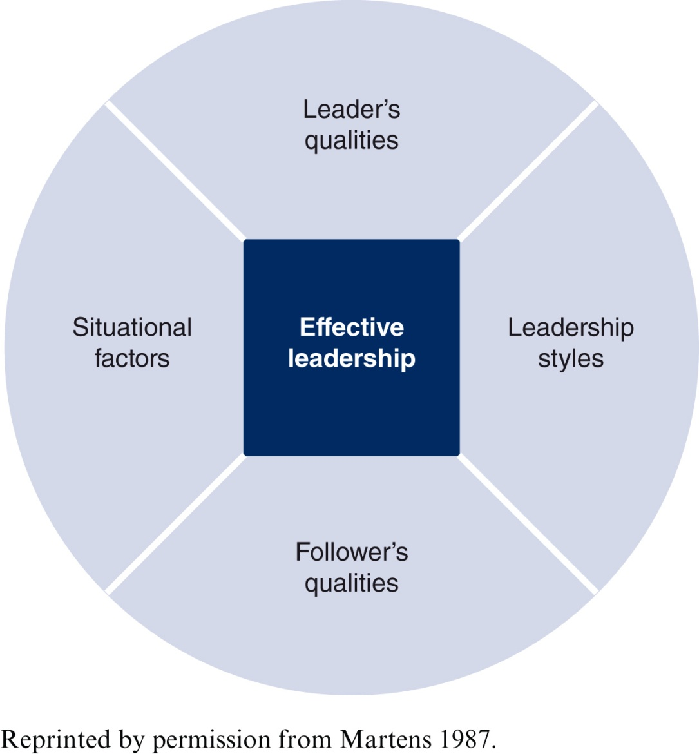
Figure 9.3

Slide 45
Leader Qualities
Effective leaders have integrity, flexibility, loyalty, confidence, accountability, candor, preparedness, resourcefulness, self-discipline, and patience.
Effective leaders mobilize and focus the physical, mental, and emotional energy resources of themselves and of team members toward the team objectives.

Slide 46
Leadership Style
Democratic or autocratic
Leader’s decision-making style
What is the best style for the situation?

Slide 47
Situational Factors
Team or individual
Interactive or coactive
Team size
Available time
Traditional leadership style

Slide 48
Follower Qualities
Experience
Gender
Ability
Age, experience, maturity
Nationality
Personality

